Slide 1
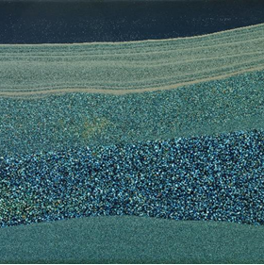
Institute for Modelling Hydraulic and Environmental Systems
Department of Hydromechanics and Modelling of Hydrosystems
FluidFlower Benchmark:
Community Simulation Results
Bernd Flemisch
26.04.2022

Slide 2
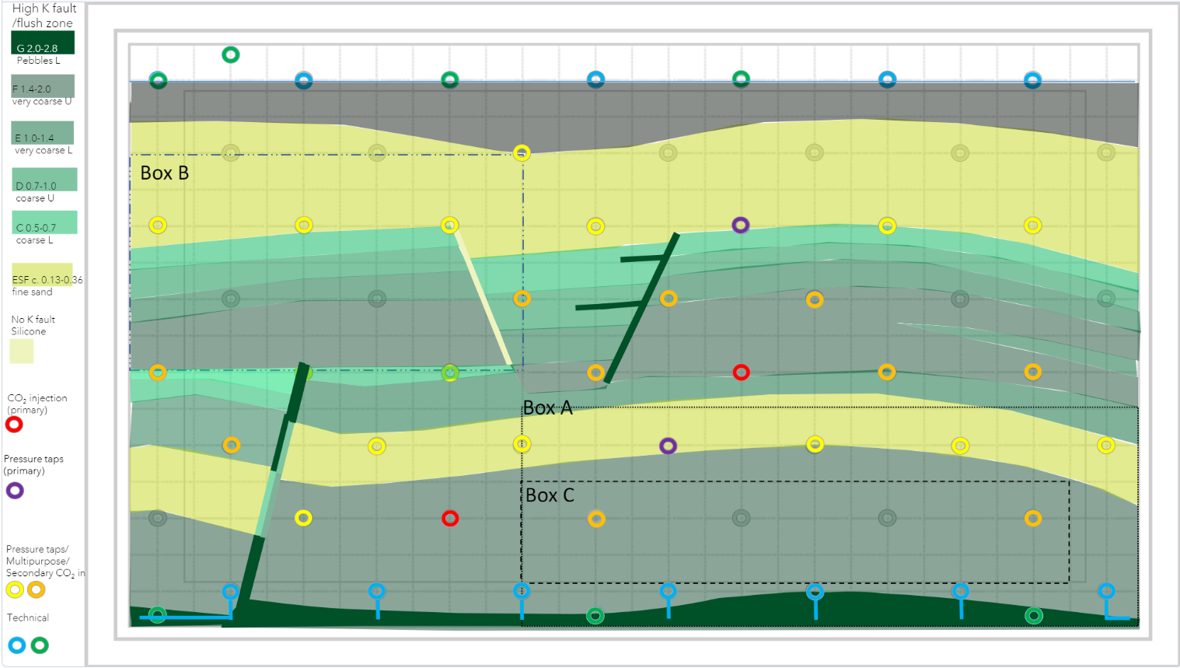
The intended geometry

Slide 3
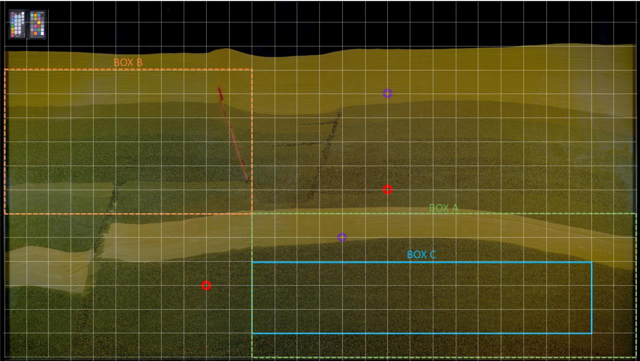
The implemented geometry

Slide 4
Reported Results Map of Phase Compositions
To be reported for each 24 hours after injection starts on a uniform Cartesian grid of 286 by 123 cells. For each temporal snapshot indicated by X hours, X = 24, 48, …, cell values should be provided in csv format in a file spatial_map_<X>h.csv of the form
# x, y, saturation [-], concentration [kg/m3] 5.000e-03, 5.000e-03, 1.234e+56, 1.234e+56 1.500e-02, 5.000e-03, 1.234e+56, 1.234e+56 … 2.855e+00, 5.000e-03, 1.234e+56, 1.234e+56 5.000e-03, 1.500e-02, 1.234e+56, 1.234e+56 1.500e-02, 1.500e-02, 1.234e+56, 1.234e+56 … … 2.845e+00, 1.225e+00, 1.234e+56, 1.234e+56 2.855e+00, 1.225e+00, 1.234e+56, 1.234e+56
The origin of the coordinate system should be located in the lower left corner with the x-axis positively oriented towards the right and the y-axis positively oriented towards the top.

Slide 5
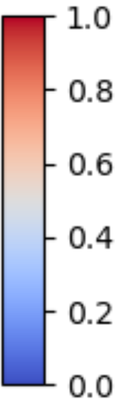
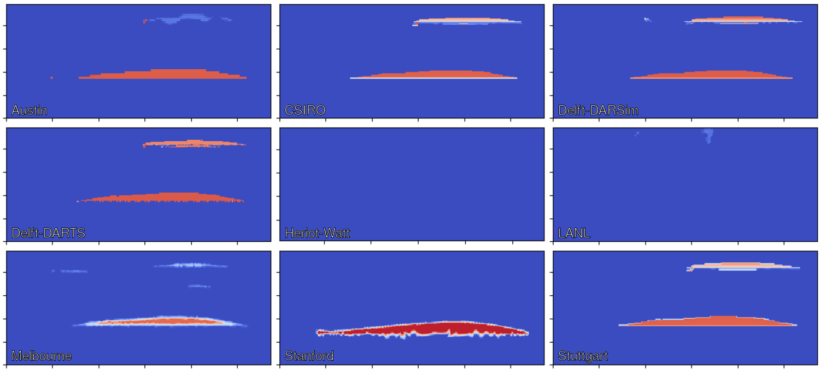
Spatial Maps: Saturation [-] at t = 24 h

Slide 6
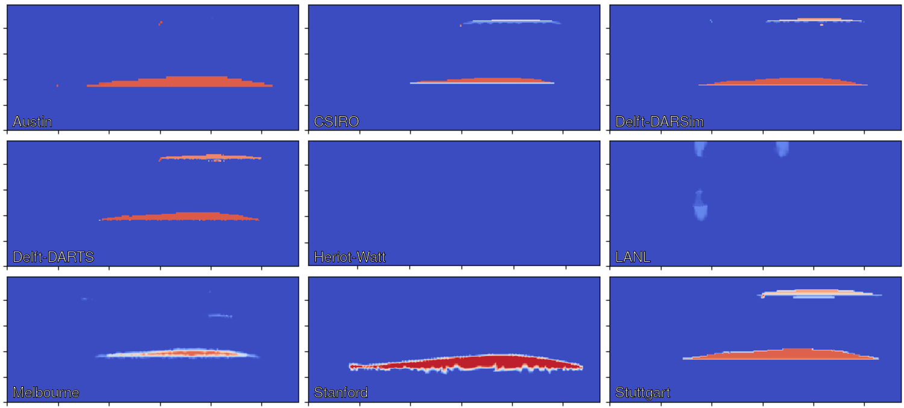
Spatial Maps: Saturation [-] at t = 48 h

Slide 7
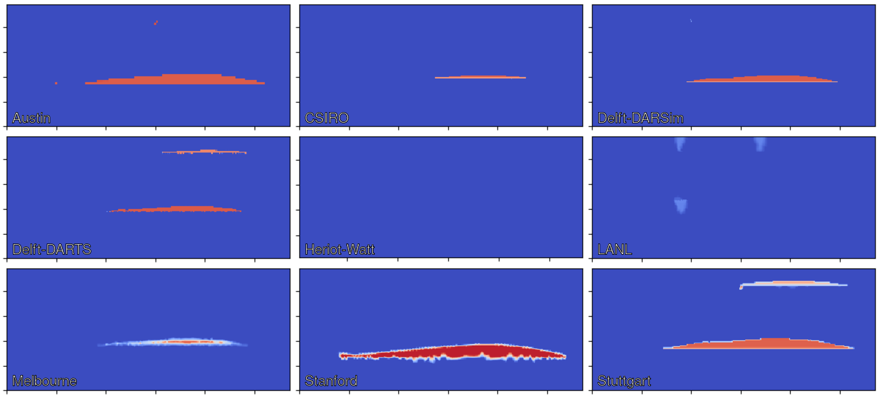
Spatial Maps: Saturation [-] at t = 72 h

Slide 8
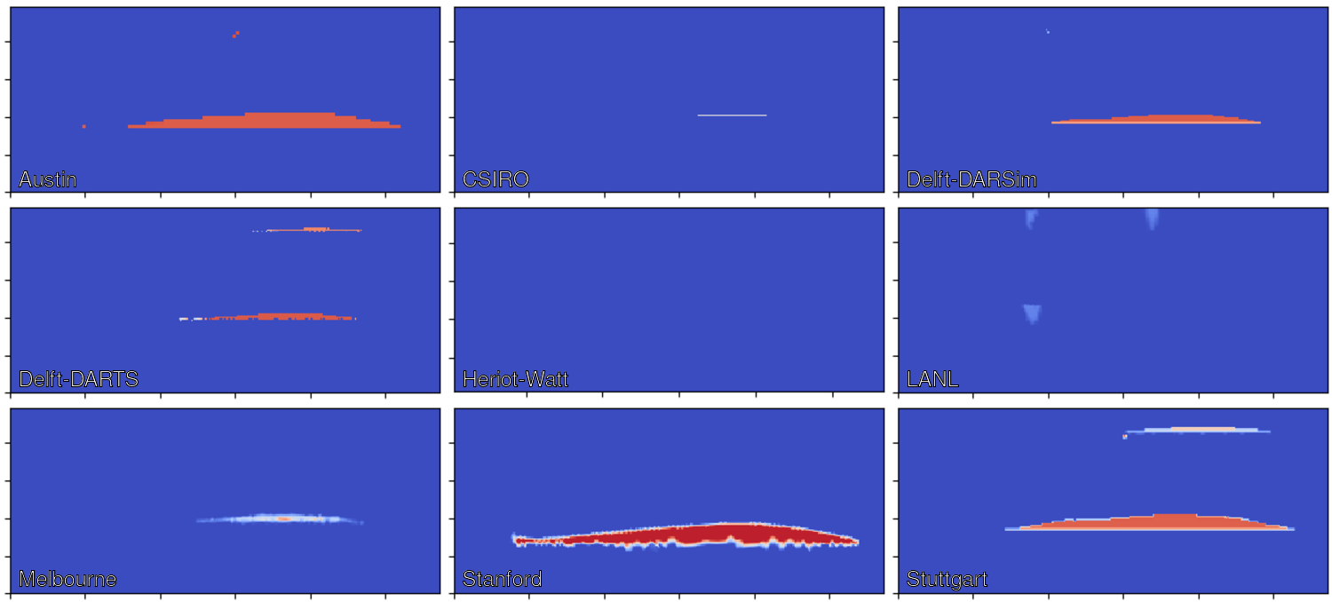
Spatial Maps: Saturation [-] at t = 96 h

Slide 9
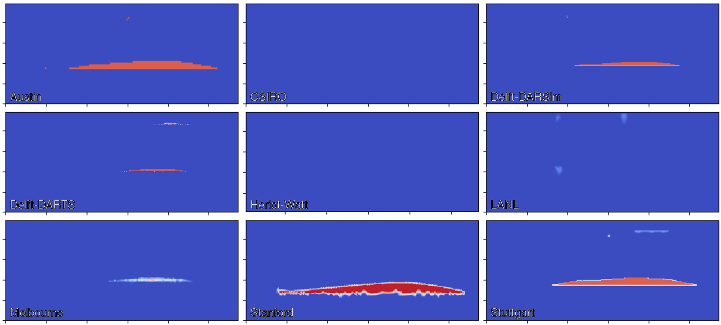
Spatial Maps: Saturation [-] at t = 120 h

Slide 10
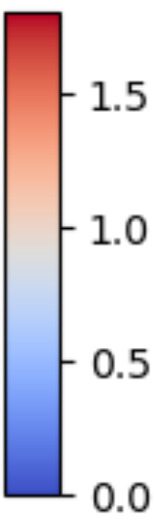
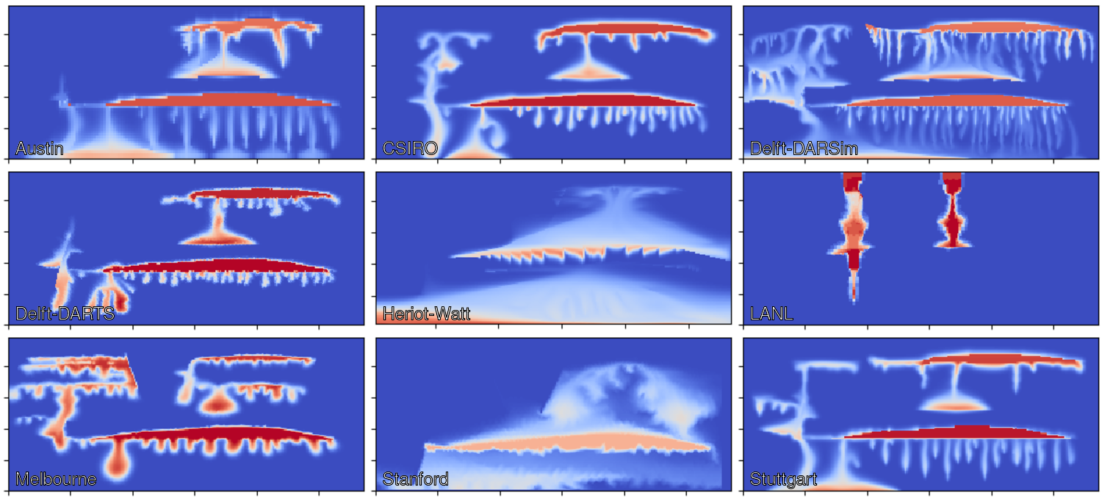
Spatial Maps: Concentration [kg/m³] at t = 24 h

Slide 11
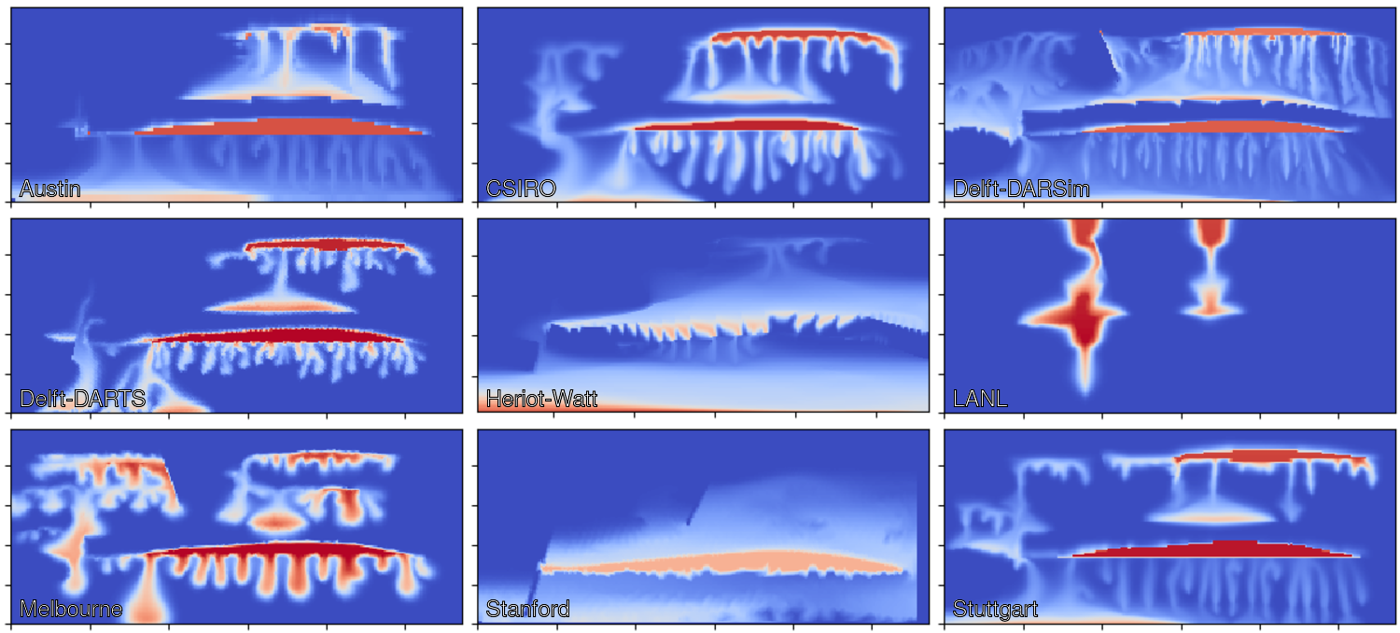
Spatial Maps: Concentration [kg/m³] at t = 48 h

Slide 12
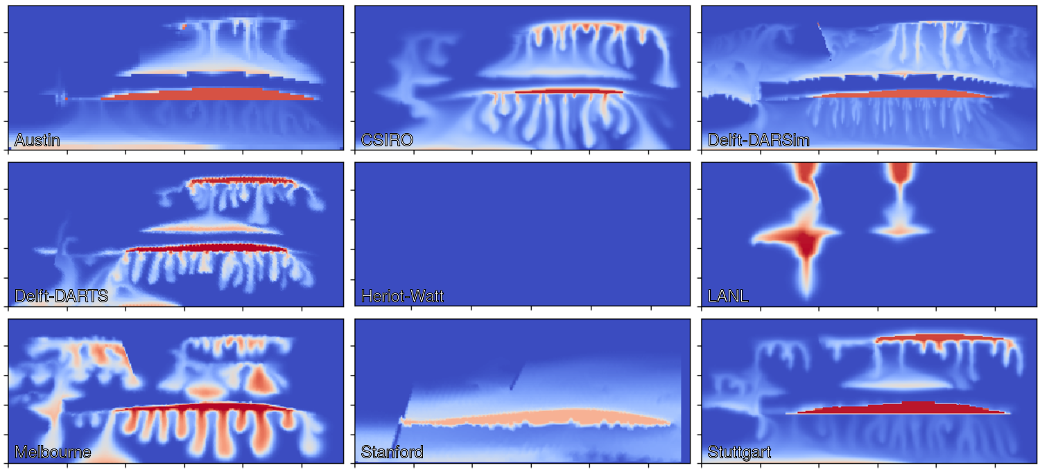
Spatial Maps: Concentration [kg/m³] at t = 72 h

Slide 13
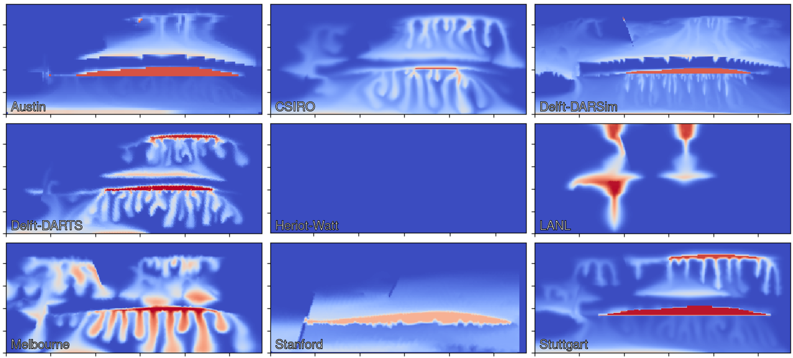
Spatial Maps: Concentration [kg/m³] at t = 96 h

Slide 14
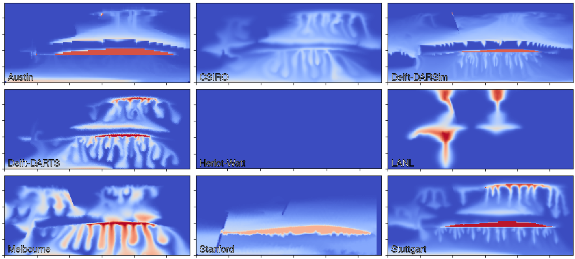
Spatial Maps: Concentration [kg/m³] at t = 120 h

Slide 15
Reported Results Dense Data Time Series
All measurables identified in section 2.7 shall be reported at 10-minute intervals starting at the initial injection and lasting 120 hours. The data is expected in csv format in a file time_series.csv of the form
# t, p_1, …, totalCO2Mass 0.000e+00, 1.234e+56, 1.234e+56, <…> 6.000e+02, 1.234e+56, 1.234e+56, <…> ...
according to the measurables defined in section 2.7.

Slide 16
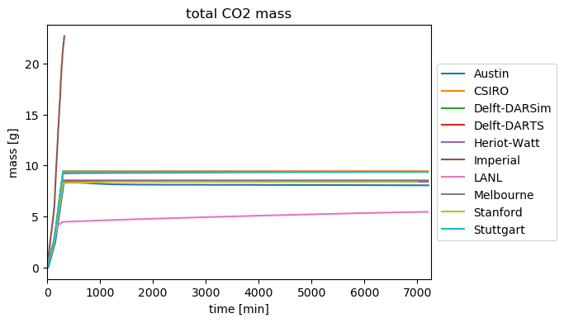
Time Series: Total CO2 Mass

Slide 17
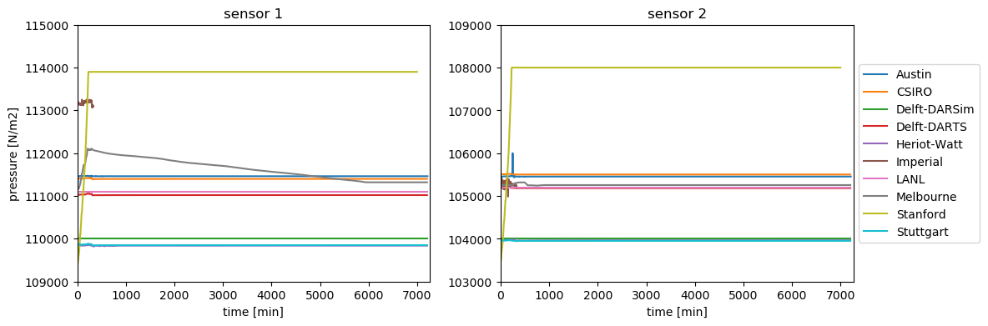
Time Series: Pressure

Slide 18
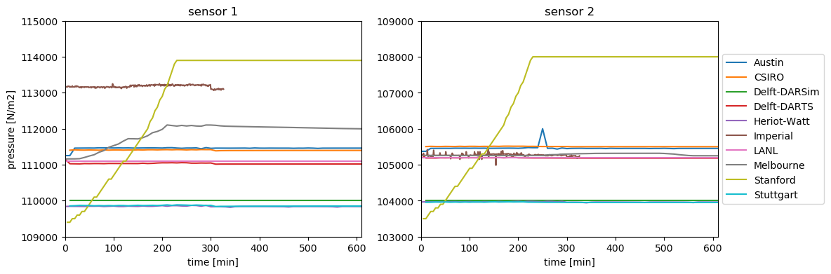
Time Series: Pressure Zoom into Time

Slide 19
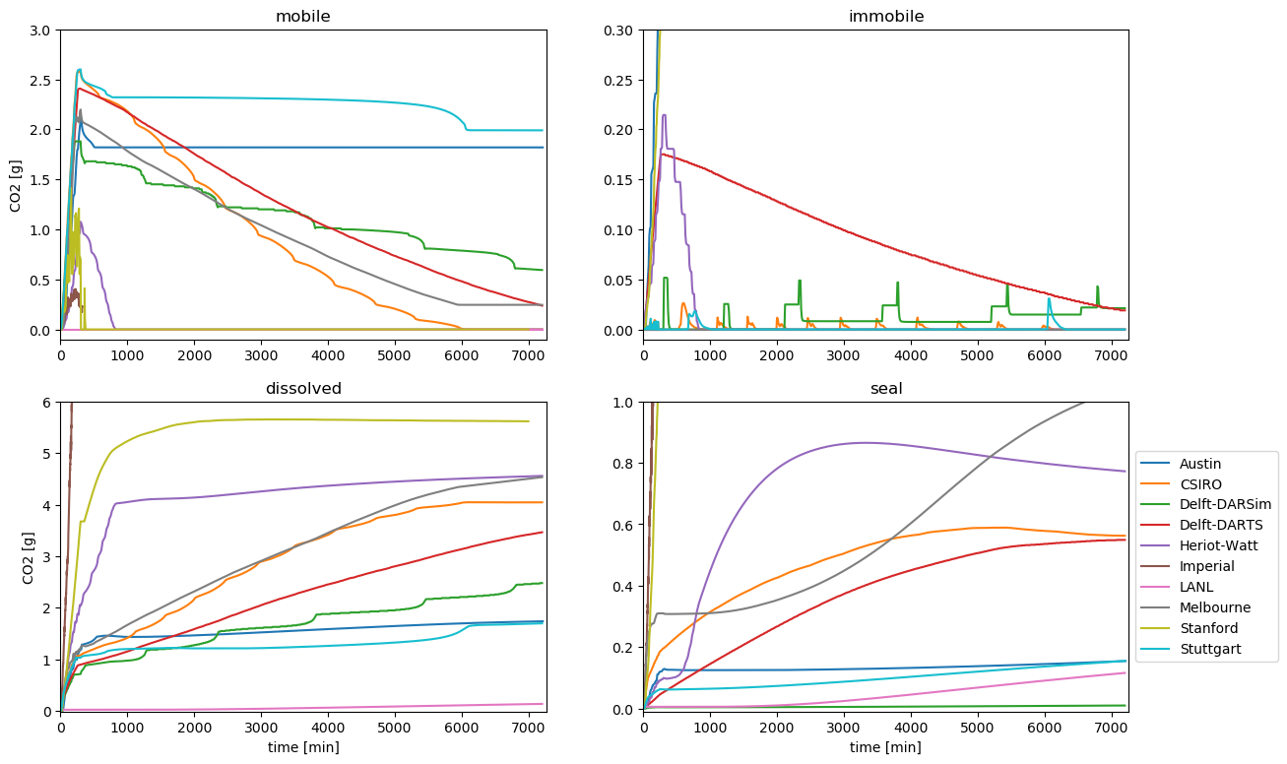
Time Series: Box A

Slide 20
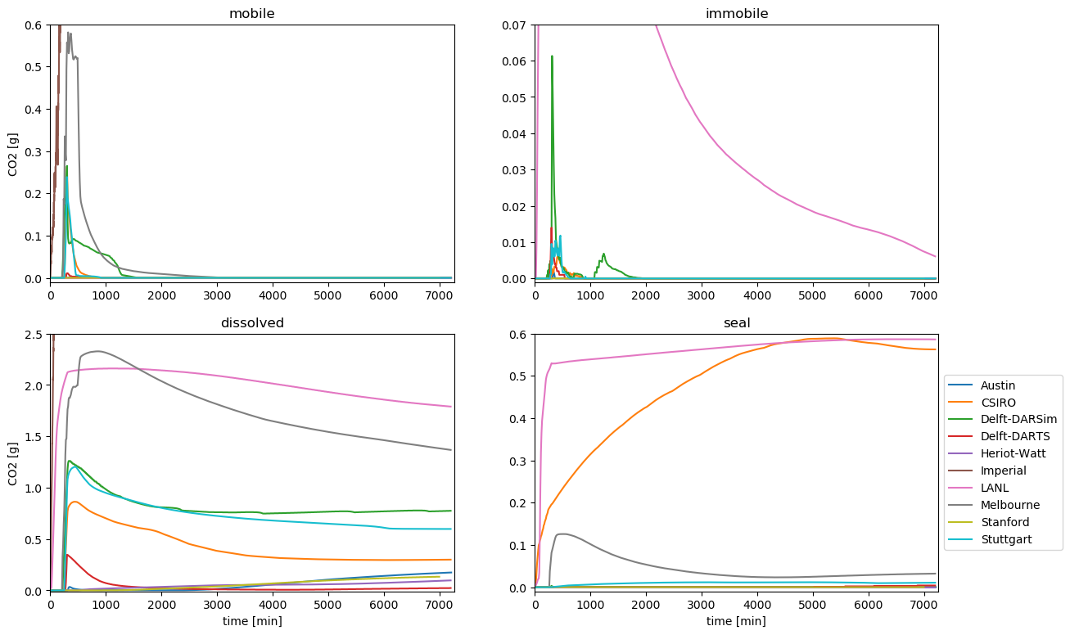
Time Series: Box B

Slide 21
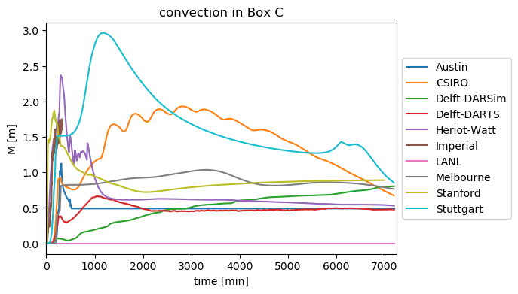
Time Series: Box C

Slide 22
Reported Results Sparse Data Determination
Each of the sparse data shall be reported as six numbers:
Prediction of the mean quantity as obtained by the experiments
Prediction in the standard deviation of the quantity over the ensemble of experiments
Stated in terms of P10, P50 and P90 values
Mean values assess the capability of predicting the various measurables
Standard deviations address the extent to which these quantities are deterministic
Any preferred methodology may be chosen:
ensemble runs
methods from uncertainty quantification
human intuition from experience

Slide 23
Reported Results Sparse Data Format
The quantities are expected to be uploaded to the repository in form of a csv file sparse_data.csv of the form
# idx, p10_mean, p50_mean, p90_mean, p10_dev, p50_dev, p90_dev 1a, 1.234e+56, <…>, # pressure at sensor 1 [N/m2] 1b, 1.234e+56, <…>, # pressure at sensor 2 [N/m2] 2, 1.234e+56, <…>, # time of max mobile free phase in Box A [s] 3a, 1.234e+56, <…>, # mobile free phase in Box A at 72h [kg/m2] 3b, 1.234e+56, <…>, # immobile free phase in Box A at 72h [kg/m2] 3c, 1.234e+56, <…>, # dissolved in water in Box A at 72h [kg/m2] 3d, 1.234e+56, <…>, # seal in Box A at 72h [kg/m2] 4a-d <same for Box B> 5, 1.234e+56, <…>, # time when M exceeds 110% of Box C’s width [s] 6, 1.234e+56, <…>, # total mass of CO2 in the top seal facies [kg]

Slide 24
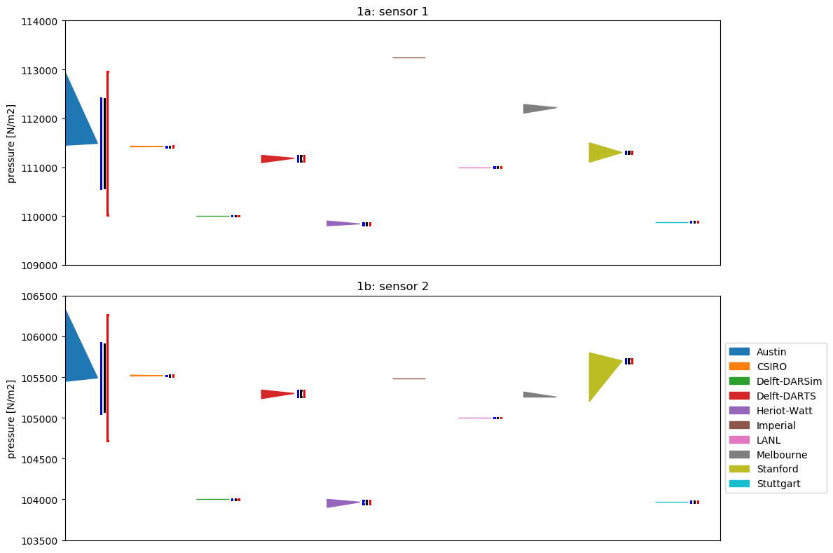
Sparse Data: Pressure

Slide 25
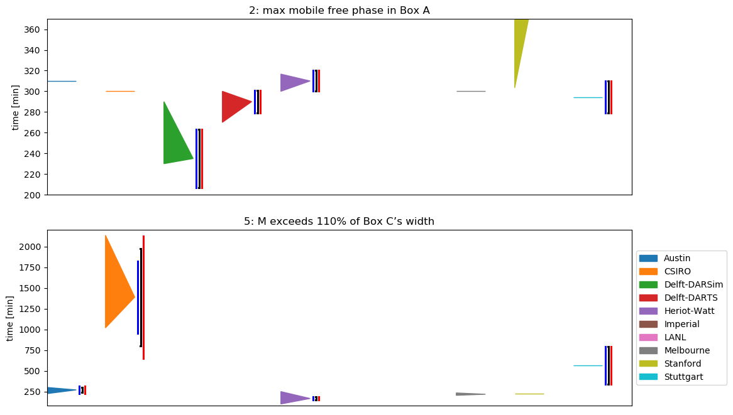
Sparse Data: Time

Slide 26
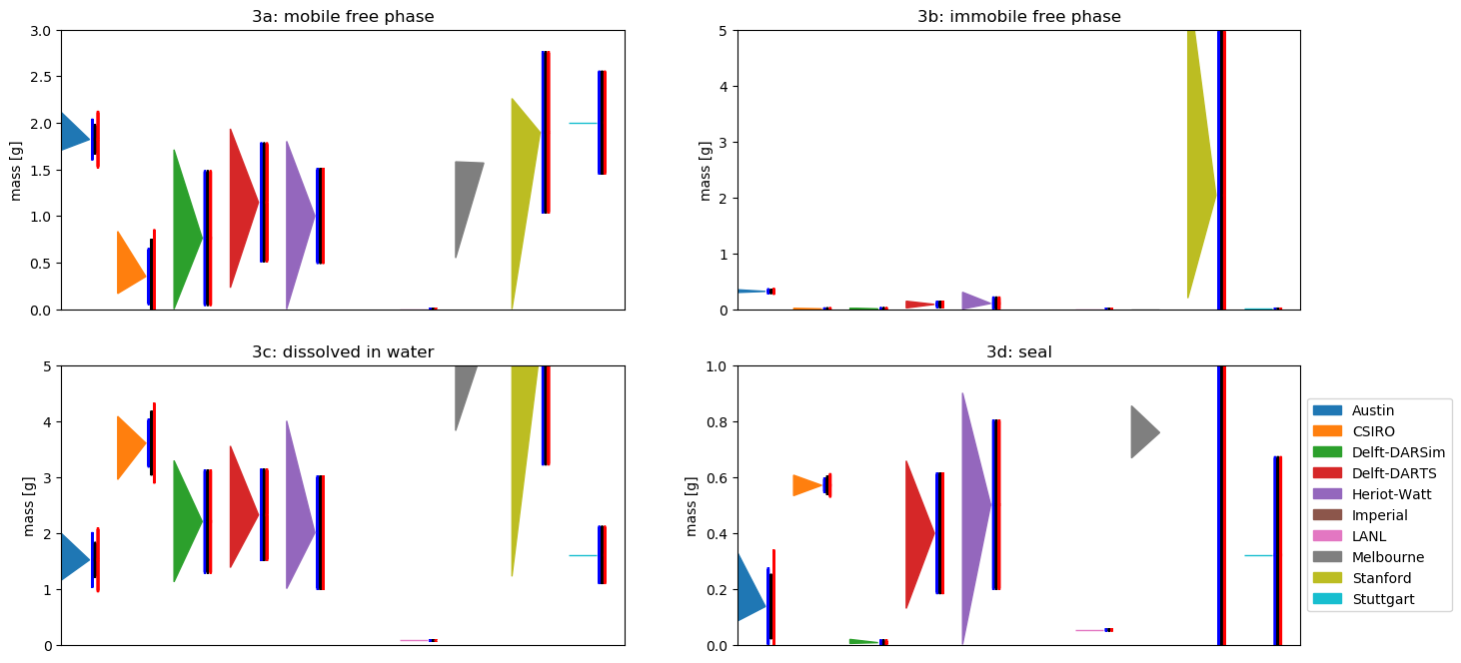
Sparse Data: CO2 in Box A at 72 h

Slide 27
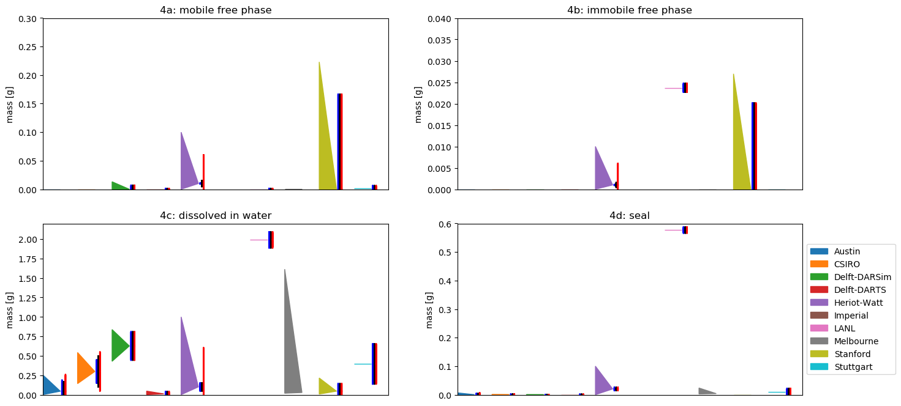
Sparse Data: CO2 in Box B at 72 h

Slide 28
Sparse Data: CO2 in Box B at 72 h

Slide 29
Sparse Data: Austin

Slide 30
Sparse Data: CSIRO

Slide 31
Sparse Data: Delft-DARSim

Slide 32
Sparse Data: Delft-DARTS

Slide 33
Sparse Data: Heriot-Watt

Slide 34
Sparse Data: Imperial

Slide 35
Sparse Data: LANL

Slide 36
Sparse Data: Melbourne

Slide 37
Sparse Data: Stanford

Slide 38
Sparse Data: Stuttgart

Slide 39
Modeling Choices, Discretization and Performance
Type | CSIRO | Delft-DARSim | Herriot-Watt | Imperial | LANL | Stanford | Stuttgart
Solubility limit [kg/m³] | 1.786 | 1.649 | 2.0 | 1.504
Temperature [°C] | 20.0 | 20.0 | 20.0 | 20.0
Domain volume [m³] | 0.0865 | 0.083 | 0.084 | 0.0875
Cells | 44,284 | 43,758 | 42,000 | 4,437 – 30,784 | 24,748 | 6,094 / 21,392 | 26,099
Avg. Δt [s] | 1.96 / 35.9 | 13.1 / 79.8 | 100.0 | 0.16 | 6.0 | 2.28 | 20.44
Avg. nonlin. it. per time step | 3.0 / 3.0 | 1.3 / 1.0 | 10.0 | 9.9 | 1.0 | 1.07 | 7.3
Avg. linear it. per solve | - | - | - |  | - | - | -

Slide 40

Institut für Wasser- und Umweltsystemmodellierung Lehrstuhl für Hydromechanik und Hydrosystemmodellierung
Bernd Flemisch
E-Mail
bernd@iws.uni-stuttgart.de
Telefon +49 (0) 711 685-
69162
www.
iws.uni-stuttgart.de/lh2
Universität Stuttgart
IWS-LH2
Pfaffenwaldring 61, 70569 Stuttgart

